Slide 1
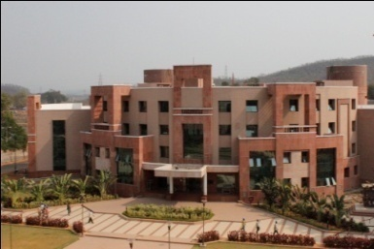

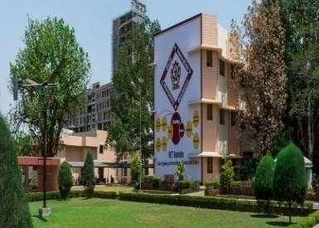

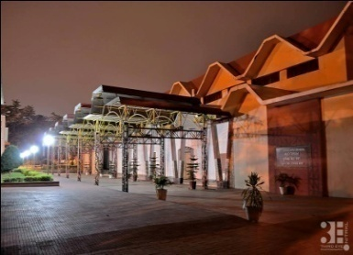
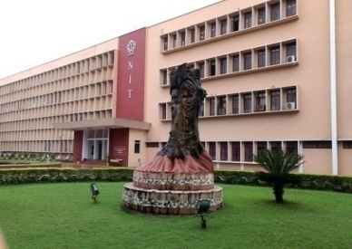
DATA COMMUNICATION (CS 3001)
National Institute of Technology Rourkela

Slide 2
Basic Performance Parameters
(a) Transit Time: The amount of time for a message to travel from sender to receiver device
(b) Response Time: Elapsed time between an enquiry and a response
(c) Reliability: f(frequency of failure, Recovery time of a system after failure, Catastrophe)
(d) Security: Unauthorized access, virus etc
The performance parameters depend on the following factors:
- Number of users
- Type of transmission medium
- Hardware
- Software

Slide 3
Applications
Marketing & Sales
Financial Services
Manufacturing
Electronic Messaging
Directory Services
Information Services
Electronic Data Interchange
Teleconferencing
Cellular Telephone
Cable Television

Slide 4
Protocols
Protocol:
Two entities (Sender/Receiver) must agree on set of rules to communicate each other
A set of rules that govern the data communication
Defines: What is communicated? How it is communicated? When it is communicated?
Key elements of a protocol:
 | Syntax | Semantics | Timing
Meaning | Structure/format of the data | Interpretation of meaning of bit patterns in the data | When & How fast the data can be transmitted
Example | First Byte: Sender Address Second Byte: Receiver Address Other Bytes: Actual message | Does an address identify the route or destination of a data | If sender Data rate exceeds the receiver data rate, the data may be lost

Slide 5
Standards
Ensures compatibility of products of different manufacturers
To maintain independency among manufacturers
To maintain an open and competitive market
To guarantee international interoperability of the product
Provides guidelines for vendors, agencies, govnt services & other service providers
Help in improving technical standards
Categories of Standards
Defacto (By fact) | De-Jure (By Law)
Adopted due to widespread use but approval is yet to be done | Legislated by an officially recognized body
Proprietary (Closed) Non-Proprietary (Open) | Defined originally by manufacturers
Invented by an organization Developed by committees/Groups
They close off communication They open communications among among vendors different systems

Slide 6
Standards Organizations
Standards are created by cooperation among standards creation committees, forums & govnt. regulating agencies
Standards Creation Committees :
ISO, ITU-T, ANSI, IEEE, EIA, Telcodia
Forum: Usually collaborate with universities to speed up the acceptance of the technology
Frame Relay Forum, ATM Forum, ATM Consortium, ISOC, IETF,
Regulating Agencies: Authority from govnt to distribute the spectrum and review the technical specifications
FCC: Federal Communication Commission (USA)

Slide 7
Standardization Process
Planning Phase
Submission of Proposals by Vendors
Checked whether the proposal is acceptable or not
If need is found, the project is assigned to a govnt. commitees
Development Phase
Scope of the project work
Liaison with othewr standard groups

Slide 8
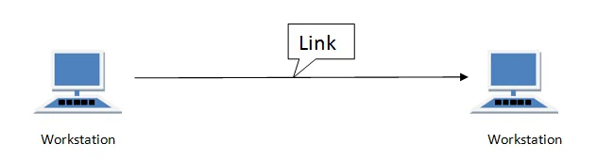
Basic Concepts
Line Configurations: The way to connect networking components
Types of Line Configurations
Point to Point connection.
Multipoint connection.

Slide 9
Point to Point
A point-to-point connection provides a dedicated link between two devices.
The entire capacity of the link is reserved for transmission between those two devices.
Most point-to-point connections use a actual length of wire or cable to connect the two end, but other options such as microwave or satellite links are also possible.
Point to point network topology is considered to be one of the easiest and most conventional network
topologies.
It is also the simplest to establish and understand.
Example: Point-to-Point connection between remote control and Television for changing the channels.

Slide 10
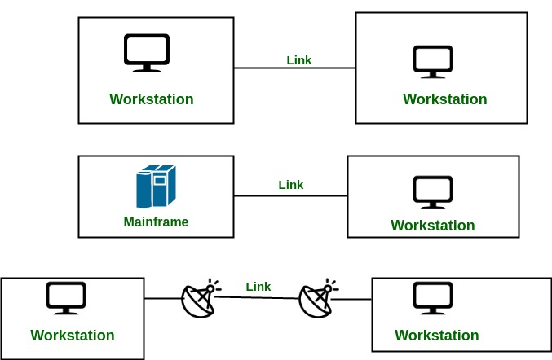

Slide 11
Multi-Point Configuration
Also known as multidrop configuration
Two or More devices share the link (Temporally or Spatially)
There are two kinds of Multipoint Connections :
If the links are used simultaneously between many devices, then it is spatially shared line configuration.
If user takes turns while using the link, then it is time shared (temporal) line configuration.

Slide 12
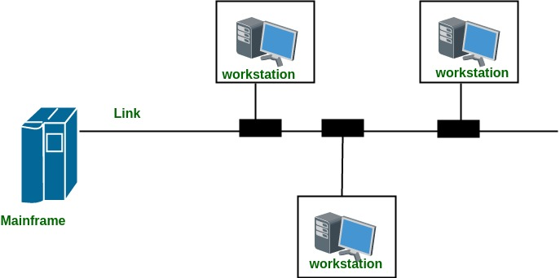

Slide 13
Frequency Bands and their Uses
Band Name | Frequency | Wavelength | Applications
Extremely Low Frequency (ELF) | 30 Hz to 300 Hz | 10,000 to 1,000 KM | Power line frequencies
Voice Frequency (VF) | 300 Hz to 3 KHz | 1,000 to 100 KM | Telephone Communications
Very Low Frequency (VLF) | 3 KHz to 30 KHz | 100 to 10 KM | Marine Communications
Low Frequency (LF) | 30 KHz to 300 KHz | 10 to 1 KM | Marine Communications
Medium Frequency (MF) | 300 KHz to 3 MHz | 1000 to 100 m | AM Broadcasting
High Frequency (HF) | 3 MHz to 30 MHz | 100 to 10 m | Long distance aircraft/ship Comns
Very High Frequency(VHF) | 30 MHz to 300 MHz | 10 to 1 m | FM Broadcasting
Ultra High Frequency (UHF) | 300 MHz to 3 GHz | 100 to 10 cm | Cellular Telephone
Super High Frequency (SHF) | 3 GHz to 30 GHz | 10 to 1 cm | Satellite/Microwave links
Extremely High Frequency (EHF) | 30 GHz to 300 GHz | 10 to 1 mm | Wireless local loop
Infrared | 300 GHz to 400 THz | 1 mm to 770 nm | Consumer Electronics
Visible Light | 400 THz to 900 THz | 770 nm to 330 nm | Optical Communications

Slide 14
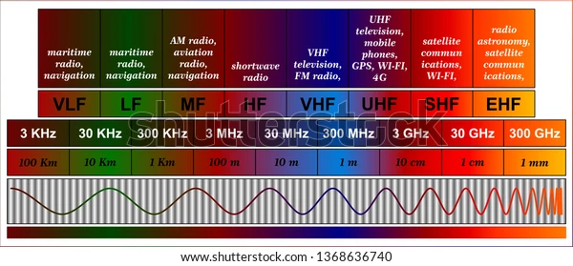

Slide 15
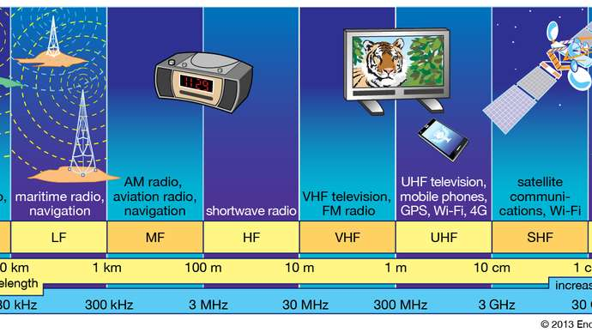
Commercially Exploited Bands

Slide 16
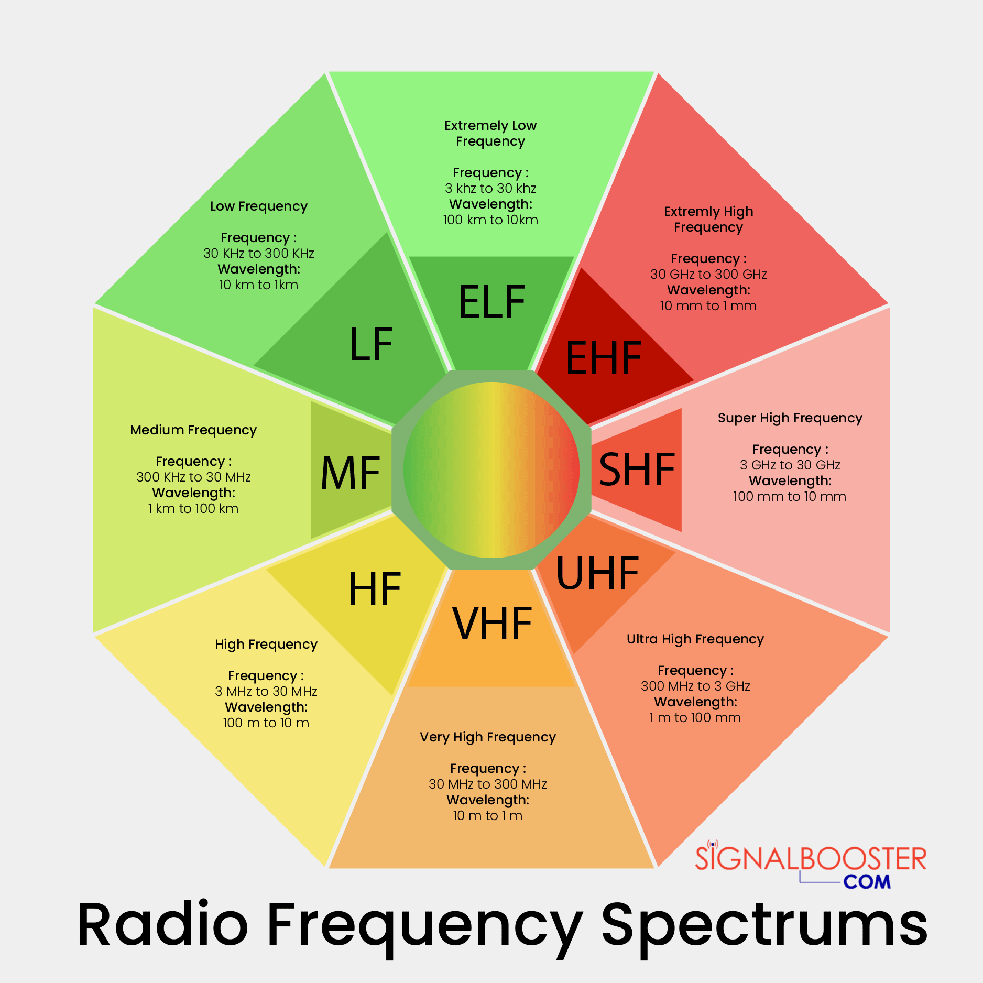

Slide 17
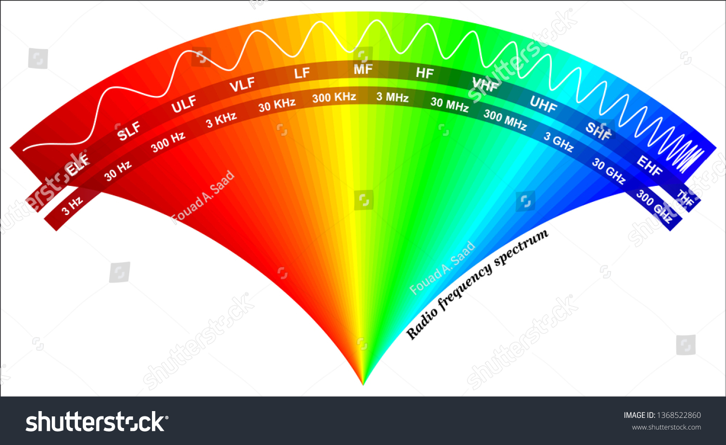

Slide 18
Transmission Limitations
Four types of limitations that affect electromagnetic wave transmissions are −
Attenuation, Distortion, Dispersion and Noise
Attenuation: The process of decreasing in the quality and the strength of the signal
Signal strength reduces over distance
The extent of attenuation = F(d, tm, f) Where
d = distance, tm = transmission-medium & f = frequency of the underlying transmission
Occurs in free space even if no other transmission impairments because the signal spreads over larger area
The units of attenuation are typically decibels.
They are a logarithmic representation of the ratio between output and input.

Slide 19
Different Types: There are different types of attenuations which include deliberate, automatic, and environmental.
Deliberate: This kind of attenuation can happen wherever a volume control can be used to reduce the level of sound over consumer electronics.
Automatic: This kind of attenuation is used to stop the distortion of sound in audio equipment and TVs by detecting automatic level to activate attenuation circuits.
Environmental: This kind of attenuation relates to loss of signal power because of the transmission medium, whether that can be connected to copper wire, fiber optic or wireless.
Ap = 10 log10 * (Ps/Pd) Where Ps = Signal Power at Source & Pd = Signal Power at Destination
Av = 20 log10 * (Vs/Vd) Where Vs = Signal Voltage at Source & Vd = Signal Voltage at Destin

Slide 20
Causes of Attenuation
Can be occurred in wired as well as wireless transmissions due to signaling issues
Transmission Medium
Crosstalk
Connectors and Conductors
Noise
Physical environment
Travel Distance
Solution To Reduce Attenuation: Using Repeaters/Relay

Slide 21
Transmission Limitations
Distortion: Any change that alters the basic relation between the frequency components of a signal or the amplitude levels of a signal
Causes disturbance to the properties of signal, adding some unwanted components, which affects the quality of the signal.
This is usually in FM receiver, where the received signal, sometimes gets completely disturbed giving a buzzing sound as the output.
Distortions are almost always represented as ratios of signal to distortion.
Results are typically expressed as a percentage (%) or in decibels (dB).

Slide 22
Transmission Limitations
Dispersion: is the phenomenon, in which the velocity of propagation of an Electromagnetic wave is wavelength dependent.
The phenomenon of spreading of a burst of electromagnetic energy during propagation.
It is especially prevalent in wireline transmissions such as an optical fiber.
Bursts of data sent in rapid succession tend to merge due to dispersion.
The longer the length of the wire, the more severe is the effect of dispersion.
The effect of dispersion is to limit the product of R and L
Where ‘R’ is the data rate & ‘L’ is distance.
Dispersion can be calculated using various measures like mean, standard deviation, variance, etc on amount of energy spent during propagation.

Slide 23
Noise
Noise: Any unwanted form of energy tending to interfere with the proper and easy reception and reproduction of wanted signals
The most pervasive form of noise is thermal noise.
Often modeled using an additive Gaussian model.
Usually measured in Decibel (dB)
dB was named after the inventor of telephone “Grahambell”
dB is a logarithmic scale to accommodate a large range of values
.

Slide 24
Types of Noise:
Thermal noise: is due to the thermal agitation of electrons and is uniformly distributed across the frequency spectrum.
Inter modulation noise − Caused by signals produced at frequencies that are sums or differences of carrier frequencies.
Induced Noise - Induced noise is the noise generated in a circuit by a varying magnetic or electrostatic field produced by another circuit. Induced noise, just like any other electrical noise, degrades the useful signal and may lead to equipment errors, shutdown, or malfunction.
Crosstalk − Interference between two signals.
Impulse noise − Irregular pulses of high energy caused by external electromagnetic disturbances. It may not have a significant impact on analog data but has a noticeable effect on digital data causing burst errors.

Slide 25
References: https://www.tutorialspoint.com/antenna_theory/antenna_theory_types_of_propagation.htm

Slide 26
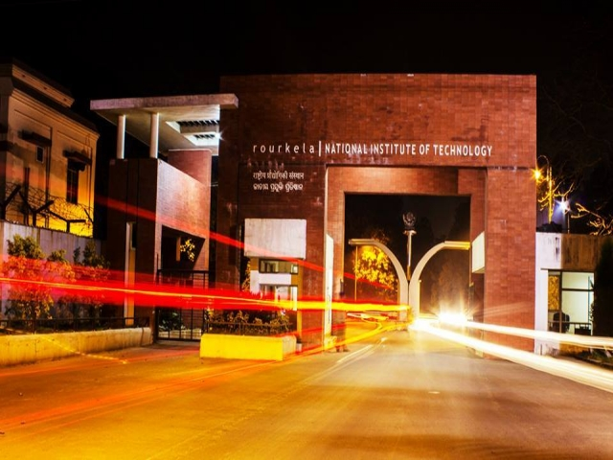
Thank You

